Slide 1
The Market of Charity
Zain Abbas, Ralph Desir, Nick B

Slide 2

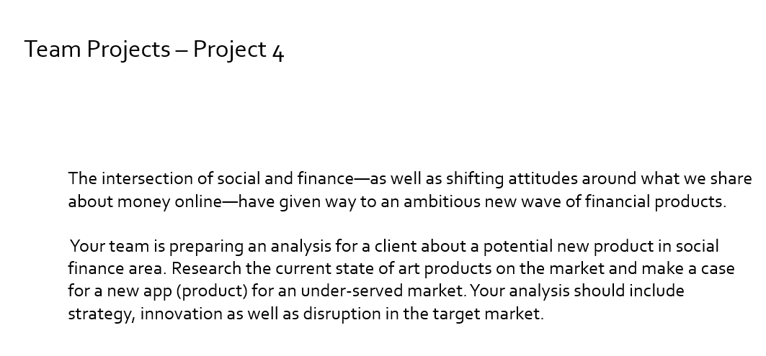
The Scenario
Our group was charged with task of developing an application in the field of social finance.
Ultimately, we decided to devise an app that connected private capital to social enterprise(Charities, Nonprofits, NGOs, etc.)

Slide 3
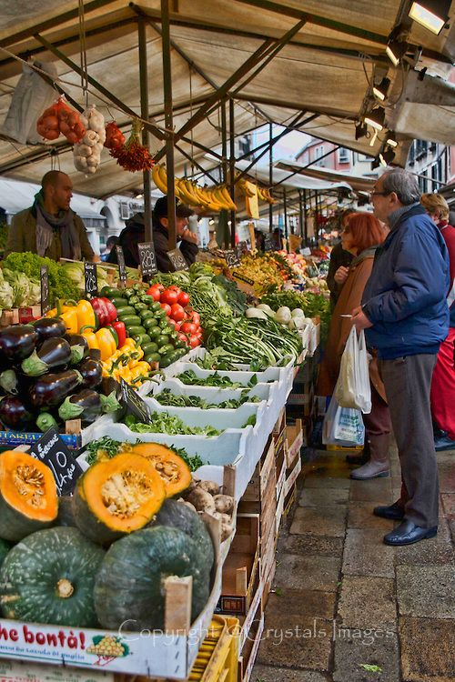
State of the Market
As with most products, it is often most important to determine whether or not it will be viable in the market it will be released in.
A product with no market, regardless of quality, will not sell well.

Slide 4
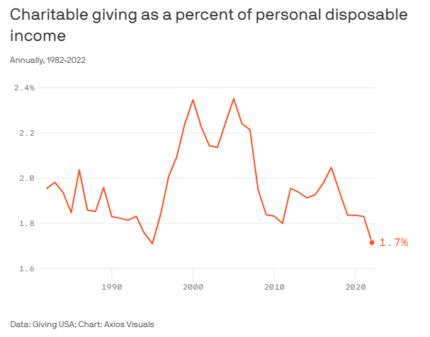
Metric of Charity
How will we measure the market for charity?
Consider the following chart:
The purpose of this chart is to show that the market of charity is surprisingly consistent.
Americans regularly contribute 1.8-2.0% of their income to charity every year.
It may appear that this percentage is falling but that can be explained by economic factors.

Slide 5
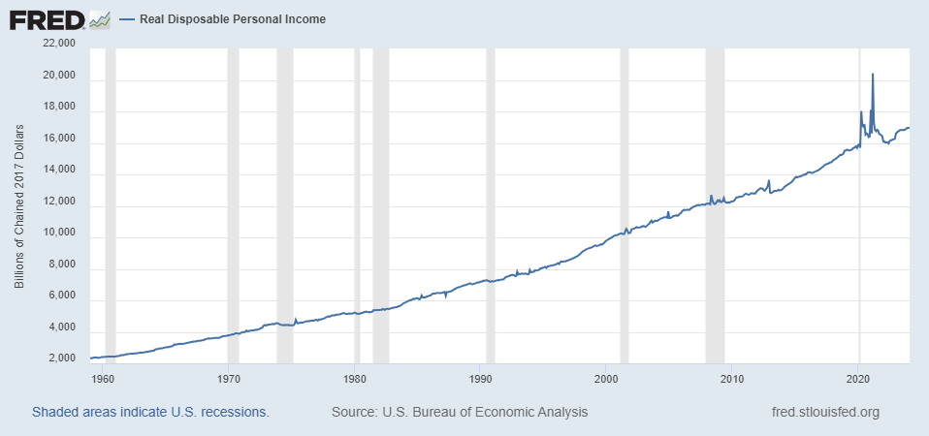
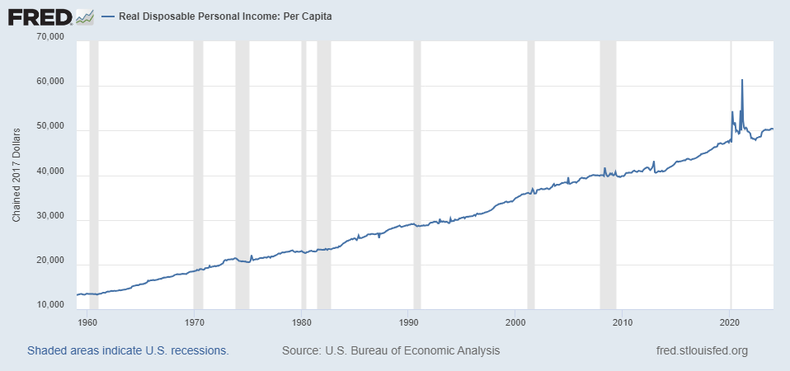
State of Consumers
Consider the following charts:
These are the Federal Reserve Economic Data graphs for Real Disposable Personal Income and Real Disposable Personal Income: Per Capita.
As can be seen, the real amount of disposable income has steadily increased since the metric has been measured.
This suggests that even if the percentage of charity has fallen, the amount given remains consistent, even growing albeit slowly.

Slide 6
Consumer Market
The conditions seem ideal, but what guarantee is there that consumers will make use of our service?
Fidelity Charitable, a public charity fund, has provided us with data suggesting that 6 in 10 Americans prefer a donation to charity in their name as opposed to a gift.
As far as guarantees go, we can only provide indicators of likelihood.
This suggests that Americans are conscious to the benefits of charity and would more actively donate if provided the means to do so. This will be explored further in the presentation.

Slide 7
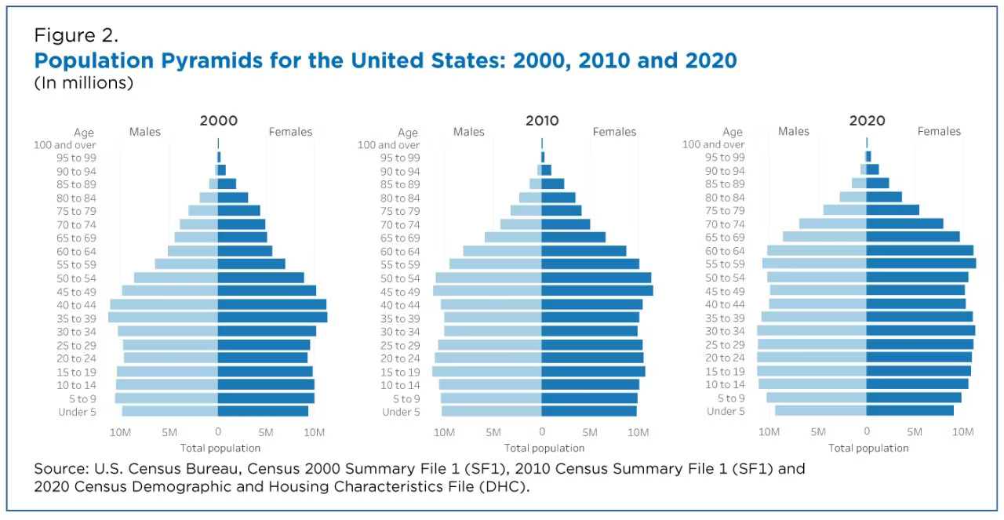
Consumer Market
Philanthropy Roundtable, a nonprofit magazine, has provided data on how subsets of the US population donate.
Of particular note is the curious fact that the greatest donator classes are the upper and lower-class populations.
Additionally, all people, regardless of class, become more charitable as they age.
In summary, Americans have more disposable income now than before along with the willingness to use it. All we have to do is provide the customer with a means to do so.

Slide 8
Growth Strategy
The overall strategy for growth is to innovate a streamlined experience for our customers.
We will provide a user-friendly interface by which to allow our customers to find, bookmark, and donate to chosen charities and nonprofits.
Additionally, all customers will be given a simple means by which to claim donations for tax benefits come tax season.
The chart is relevant as it shows that the US has a large amount of its population approaching senior age. This means that our consumer base shall likely continue to grow into the future.

Slide 9
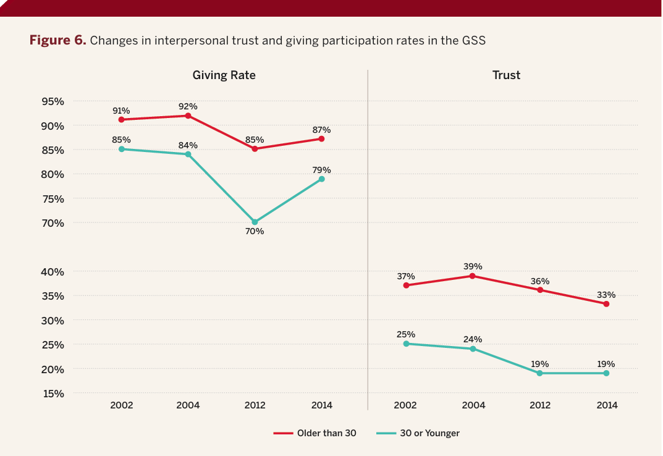
Market Disruption
The Indiana University has provided our team with statistics for US Donor Participation through use of the General Social Survey.
The data provided shows a concerning trend of dropping trust by the young in charities and nonprofits, reducing the likelihood they will donate at all.
To combat this, our team proposes a newsletter-like functionality in our app, where users are notified of acts and progress made by the charities they have donated to. This will allow our consumers to “see their dollars at work” and restore public trust in donations, thus inspiring consumers to return to our service.

Slide 10
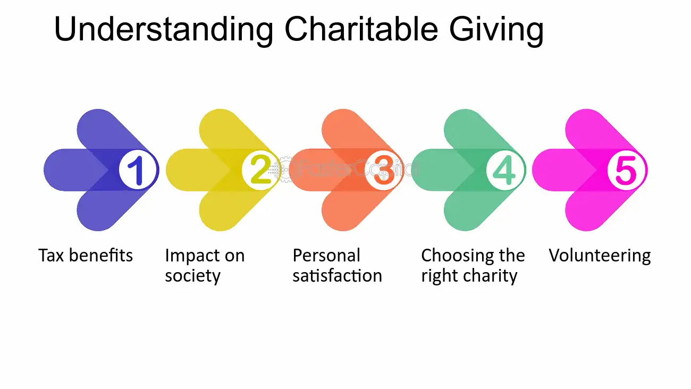

Slide 11
Donation and Tax Benefits
Study
According to Fidelity Charitable, 64% of donors want to give more to charity
About half of the donors indicate a greater tax benefit and/or the ability to take a larger tax deduction will influence them to give
More Benefits/Incentive for Donor, more Charitable Donations

Slide 12
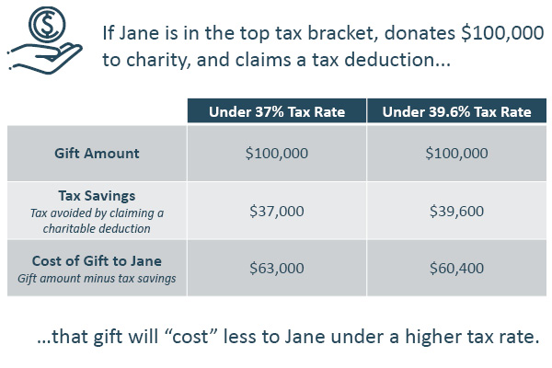

Slide 13
Qualified Tax Organizations (IRS)
Under section 170c of the IRC
A state or United States possession (or political subdivision thereof), or the United States or the District of Columbia, if made exclusively for public purposes;
A community chest, corporation, trust, fund, or foundation, organized or created in the United States or its possessions, or under the laws of the United States, any state, the District of Columbia or any possession of the United States, and organized and operated exclusively for charitable, religious, educational, scientific, or literary purposes, or for the prevention of cruelty to children or animals;
A church, synagogue, or other religious organization;
A war veterans' organization or its post, auxiliary, trust, or foundation organized in the United States or its possessions;
A nonprofit volunteer fire company;
A civil defense organization created under federal, state, or local law (this includes unreimbursed expenses of civil defense volunteers that are directly connected with and solely attributable to their volunteer services);
A domestic fraternal society, operating under the lodge system, but only if the contribution is to be used exclusively for charitable purposes;
A nonprofit cemetery company if the funds are irrevocably dedicated to the perpetual care of the cemetery as a whole and not a particular lot or mausoleum crypt.

Slide 14

Impact on Society/Personal Satisfaction
Donors Gain:
Positive Brand Reputation
Personal Satisfaction
Community Involvement
Potential Networking Opportunities

Slide 15
The App
The App fulfills the following functions:
Streamlines the process of donating to charities and similar organizations
Allows filtering and sorting organizations by a wide range of criteria
Provides resources and information on using donations as tax deductions
Utilizes an algorithm to show the user information and opportunities they are more likely to interact with

